Slide 1
Khulna University of Engineering & Technology
Department of Electrical & Electronic Engineering (EEE)
Course Title: Electrical & Electronic Shop Practice
Course no: EE 2200
Credit: 1.5
Contact Hrs: 3hrs/week

Slide 2
References
1. Electrical Wiring Estimation and Costing
- S.L. Uppal
2. Electronic Instrumentation and Measurements
- David A. Bell
Course Teachers
1. Prof. Dr. Md. Abdur Rafiq
&
2. Md. Zakir Hossain

Slide 3
Familiarization with
(a) Conventional symbols for electrical installation
(b) Electrical switches
(c) Electrical tools
Experiment 01:

Slide 4
Conventional symbols for electrical installation
Lighting and Exhaust Fans Blocks
Outlets Blocks
Climate Control Blocks
General Electrical Symbol Blocks
Gas Blocks
Water Blocks
Reflected Ceiling Plan Blocks
All Symbols From S.L. Upp4al

Slide 5
Electrical Wiring Diagram Symbols for Lighting
Surface Ceiling Light
Recessed Ceiling Light
Drop Cord Light
Landscape Light
Wall Light
Ceiling Fan

Slide 6
Electrical Wiring Diagram Symbols for Lighting (Continued….)
Multi-light Bar
Track Light
Troffer Fluorescent Light
Surface Fluorescent Light
Home Electrical Wiring Diagram Symbols for Switches
Switch
3-Way Switch
4-Way Switch
Dimmer Switch

Slide 7
Home Electrical Wiring Symbols for Outlets
Outlet
GFI Outlet
Switched Outlet
Waterproof Outlet
Floor Outlet
Quad Outlet
240 Volt Outlet

Slide 8
Home Electrical Wiring Symbols for Signals & Communications
Smoke Detector
Telecom Outlets
Stereo Outlet
Television Outlet
Doorbell Button
Doorbell Chime
Doorbell Transformer
Thermostat

Slide 9
Electrical tools
Introduction:
Wood
Stone
Iron (Metal)
Macro(Tools)
Micro(tools)

Slide 10
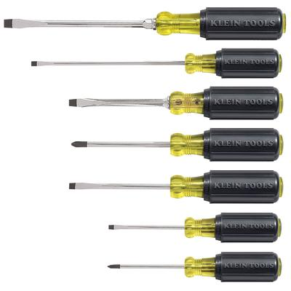
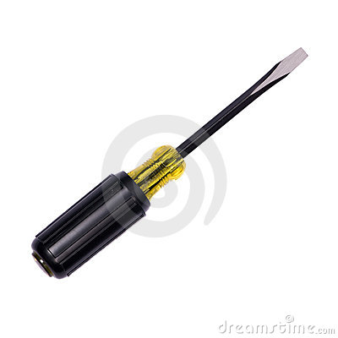
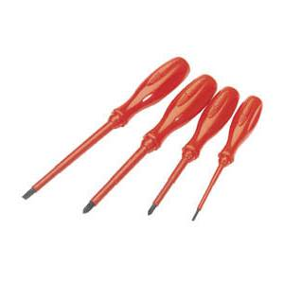
Screwdriver:
Fig. 1:Simple Screwdriver

Slide 11
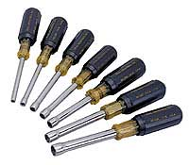
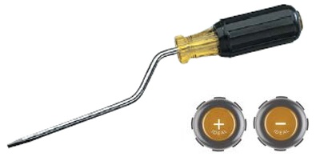
Screwdriver (Continued….)
Fig.2 :Quick rotating screwdriver

Slide 12
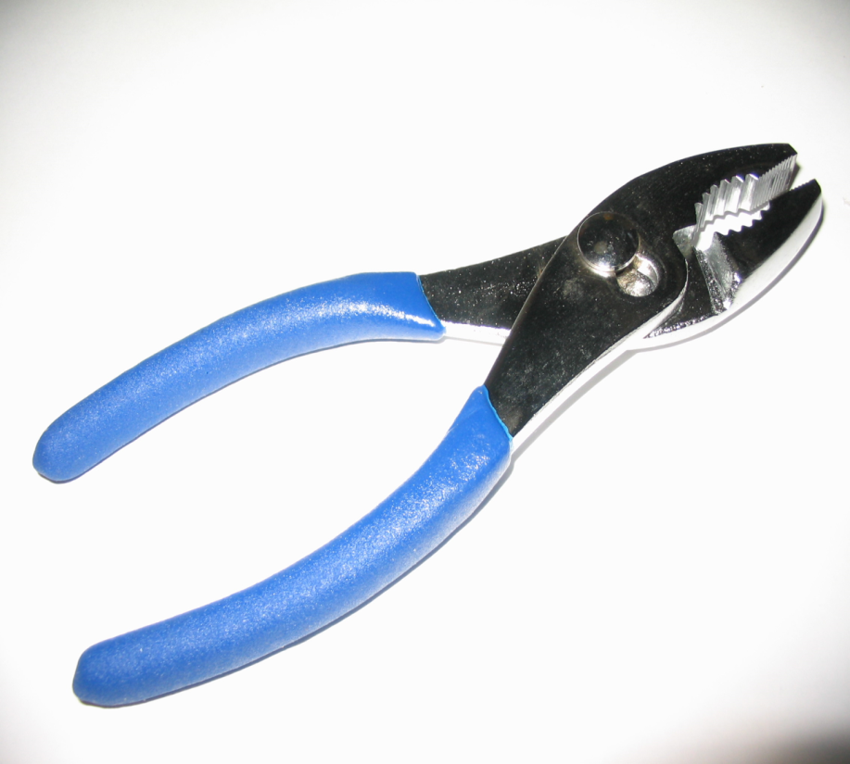
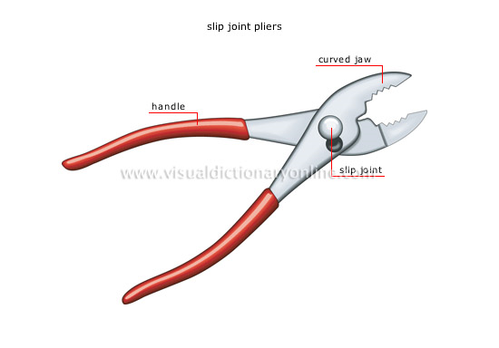
Pliers
Fig. 3:Slip Joint Pliers
Fig. 4:Hand tools with two movable jaws of fixed or variable gaps

Slide 13
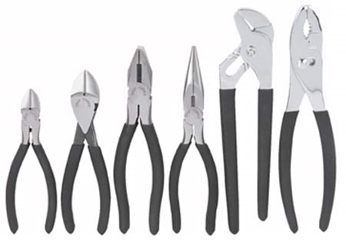
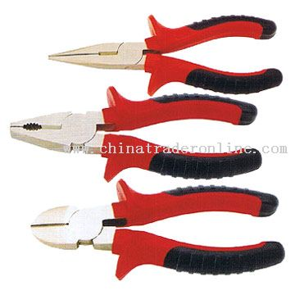
Pliers (Continued…)

Slide 14
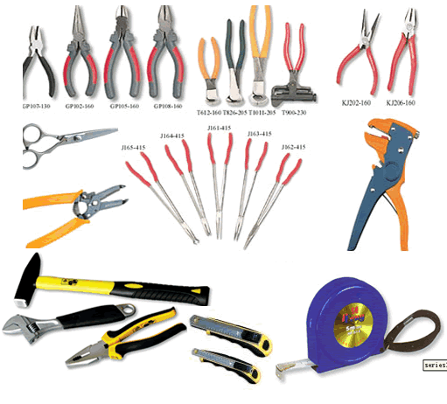
Pliers(Continued…)
Fig. 5: Pliers in summary

Slide 15
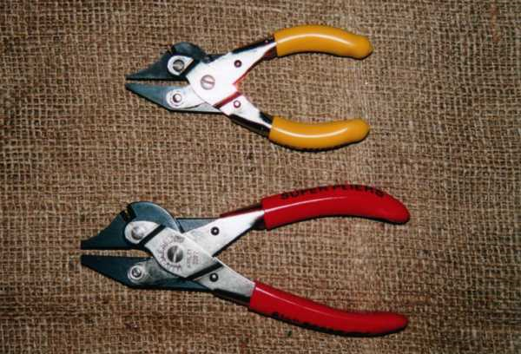
Side Cutters

Slide 16
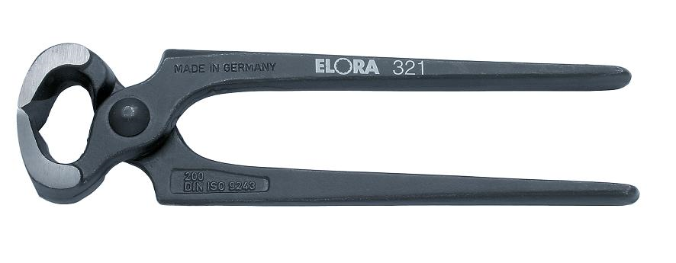
Side cutter+ Plier(Continued…)
Fig.6 :Diagonal Cutting Pliers & Nippers

Slide 17
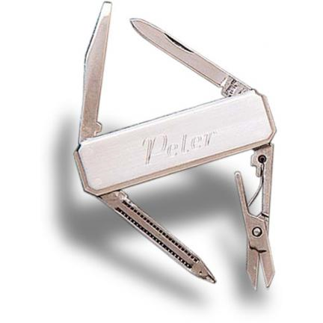

Pocket Knife
Fig.7 : Stainless Steel 4-Tool Pocket Knife
Fig. 8: Swiss Army Huntsman Lite 21 tool Pocket Knife

Slide 18
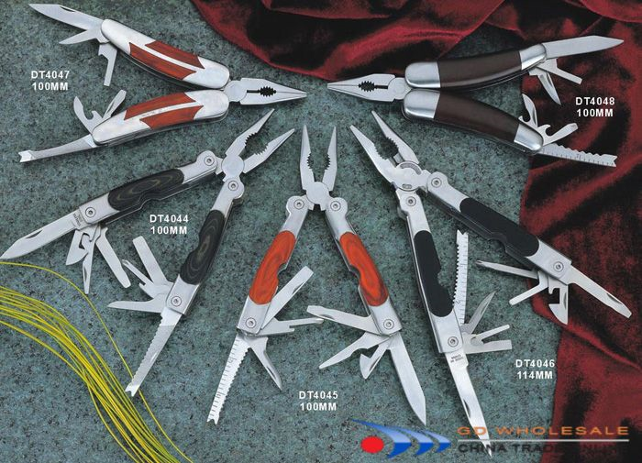
Pocket Knife(Continued…)
Fig.9 : Multi function Tool & Pocket Knife

Slide 19
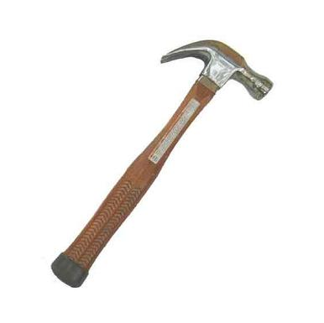
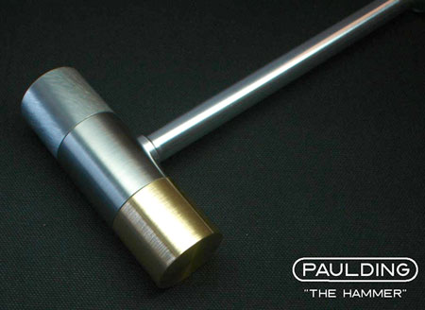
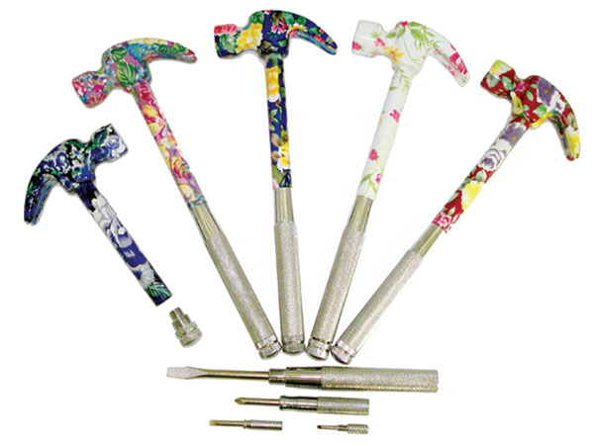
Hammer

Slide 20
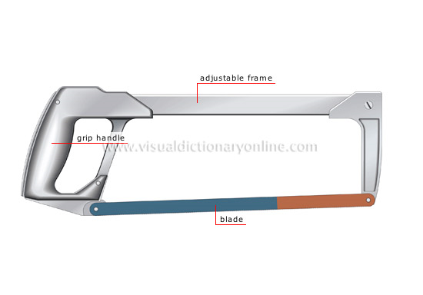
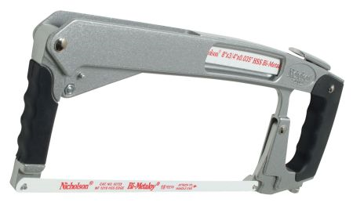
Hacksaw

Slide 21
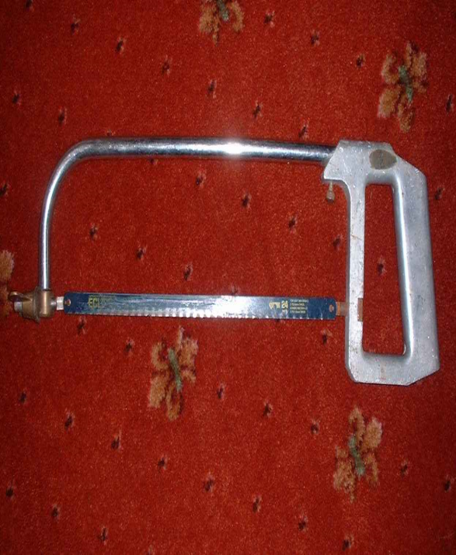
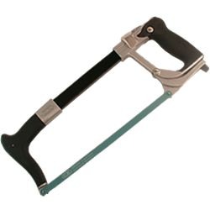
Hacksaw

Slide 22
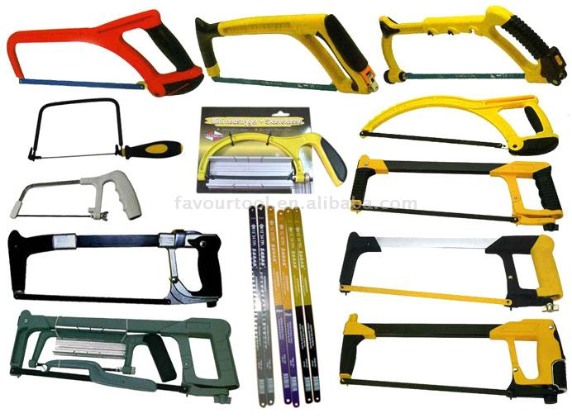
Hacksaw(Continued…)

Slide 23
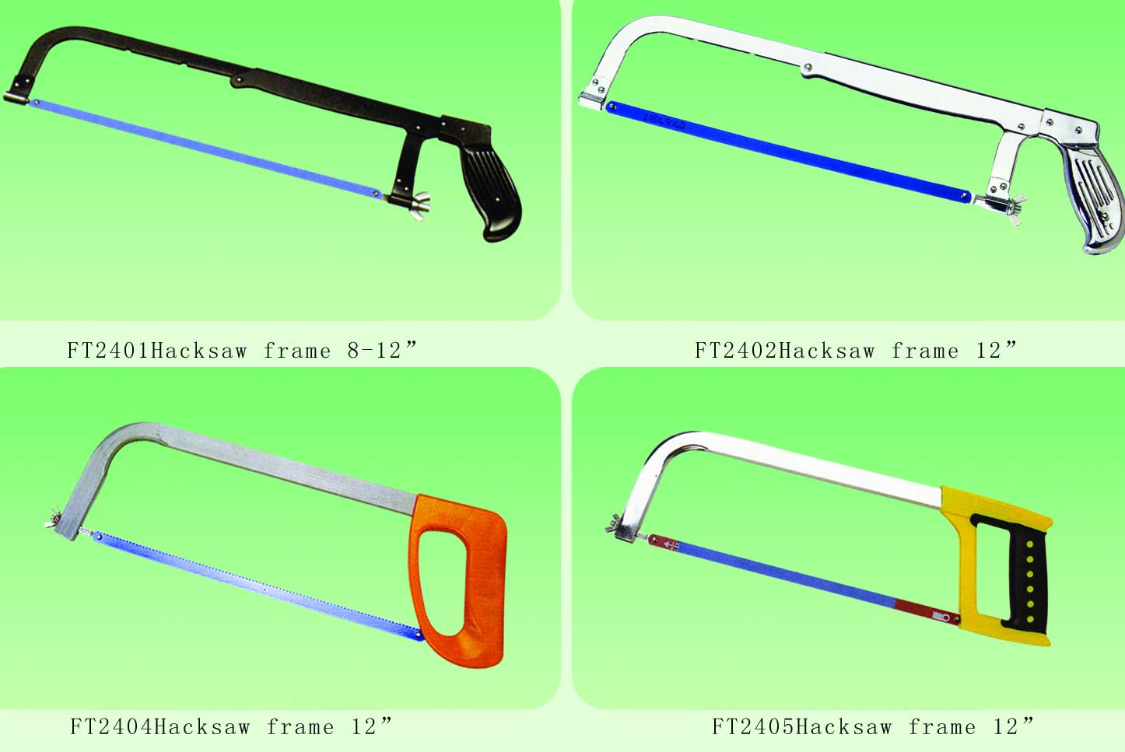
Hacksaw(Continued…)

Slide 24
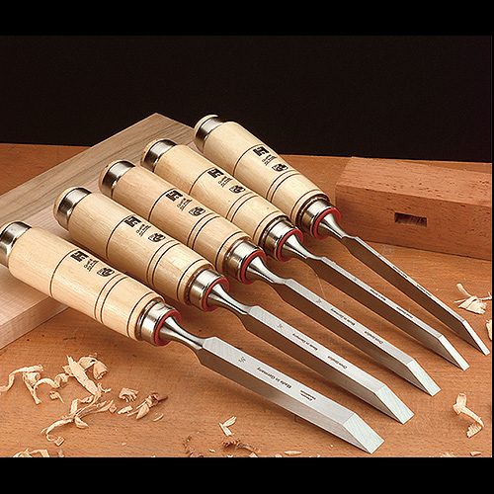
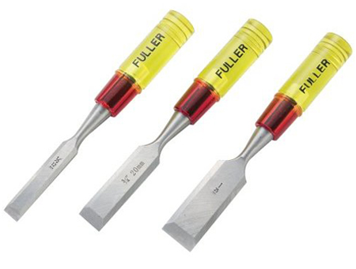

Chisel

Slide 25
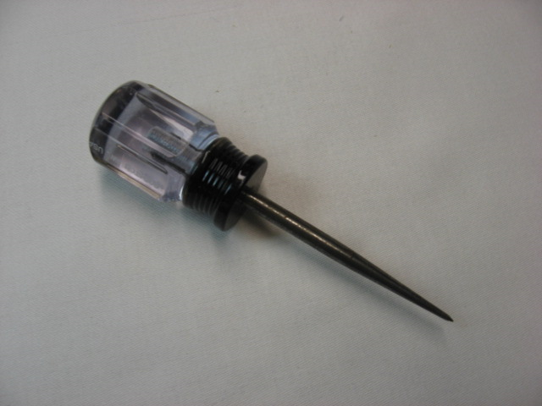
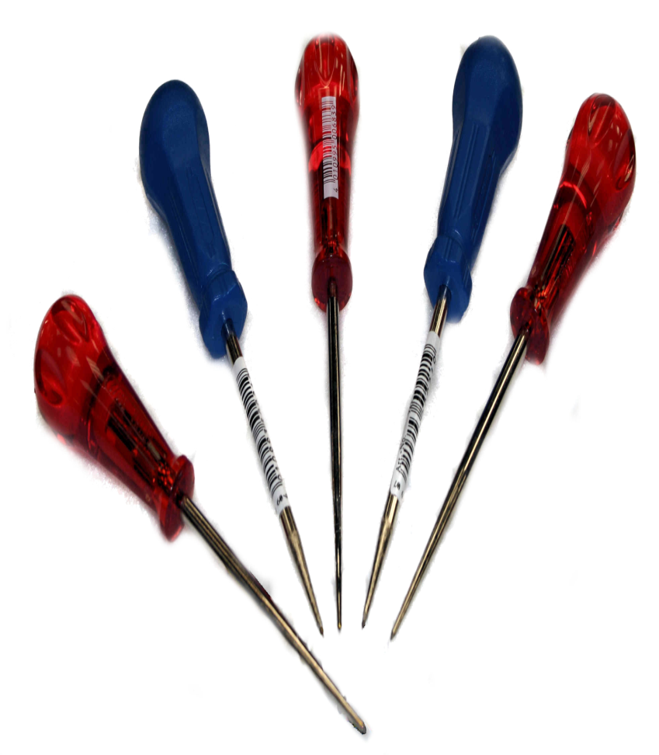
Scratch awl

Slide 26
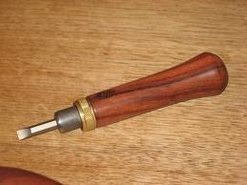
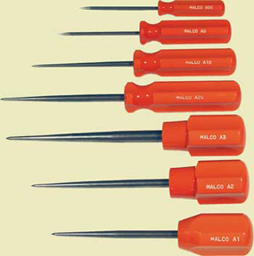
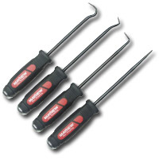
Scratch awl(Continued…)

Slide 27
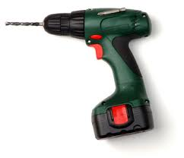
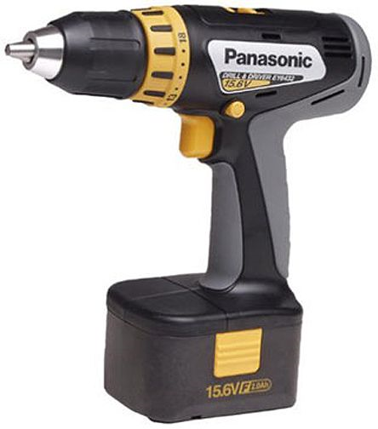
Drill

Slide 28
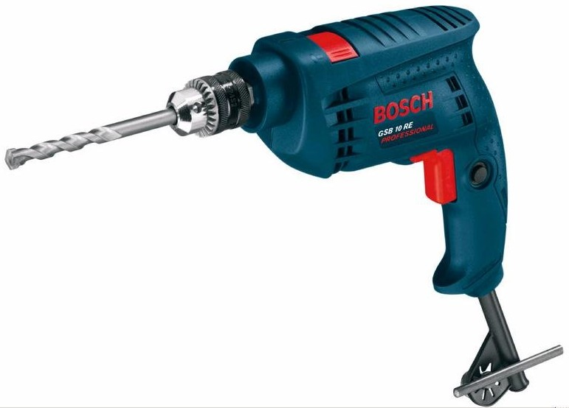
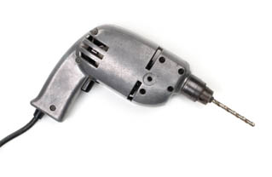
Drill(Continued…)

Slide 29
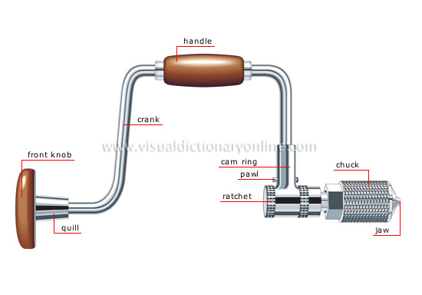
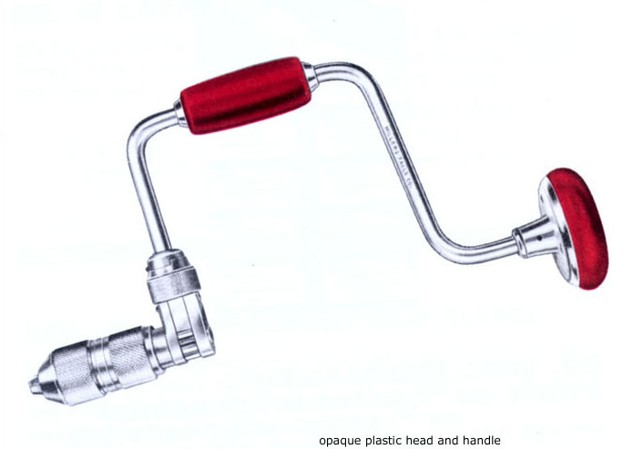
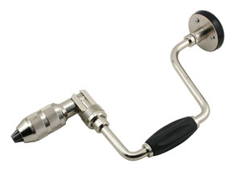
Brace (tool)

Slide 30
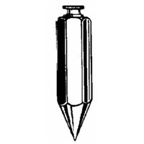
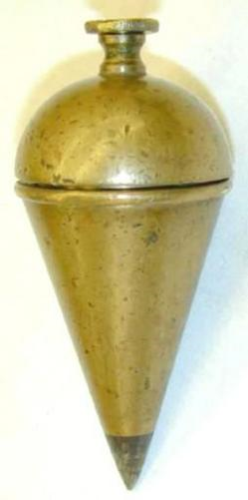
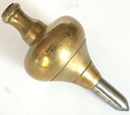
Plumb-bob

Slide 31
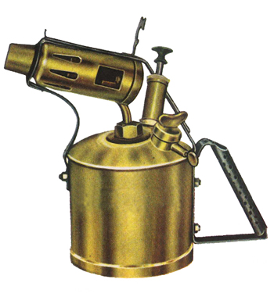
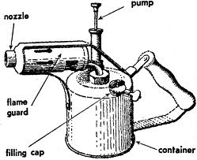
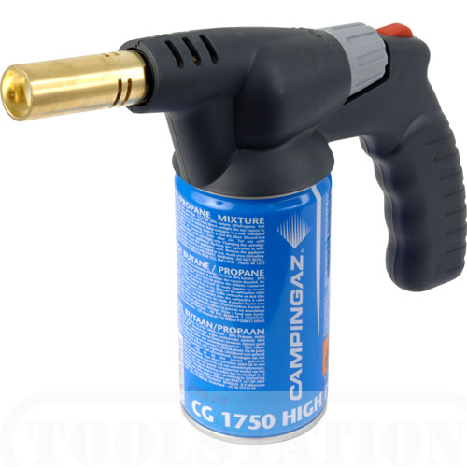
Blow Lamp

Slide 32
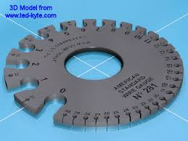
Standard wire gauge
measure that how large a wire is, either in diameter or cross sectional area
determines the amount of electrical current that a wire can safely carry, as well as its electrical resistance and weight per unit of length.

Slide 33
How to Write a Good(?) Report?
The points that need to be included in a report are-
Objectives of the experiment
Theory (If any)
Apparatus List
Diagram/ Experimental flow chart/ Set-up
Procedure
Data (If any)
Graphs(With discussion) (If any)
Results (If any)
Discussion/Conclusion

Slide 34


