Slide 1
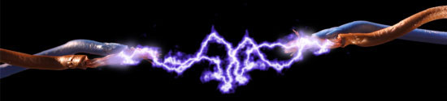
Experiment No: 02
Study on Types and Installation of wiring systems
Electrical Shop Practice
EE-2200

Slide 2
Systems by which power is distributed to domestic consumers-
1. Single phase – two wire system(domestic)
2. Three phase -three wire system(industrial)
3. Three phase -four wire system(domestic & industrial)
Energy meter
Main Switch
Lighting & Power circuits
Double Pole Iron Clad Switch(DPIC)
(domestic wiring)
Triple Pole Iron Clad Switch(TPIC)
(Industrial Installations)
Triple Pole Iron Clad Switch with neutral Link(TPNIC)
(Industrial Installation)

Slide 3
Introduction
Factors that must be considered while selecting a system of wiring-
Life of the installation
Type of wire and material used
Future extension or alternation
Nature of load (light or power load)
Construction of building
Quality of wiring system
Fire hazards or other special conditions
Dampness
Safety of the system
Appearance of the wiring systems
Cost of the wiring systems

Slide 4
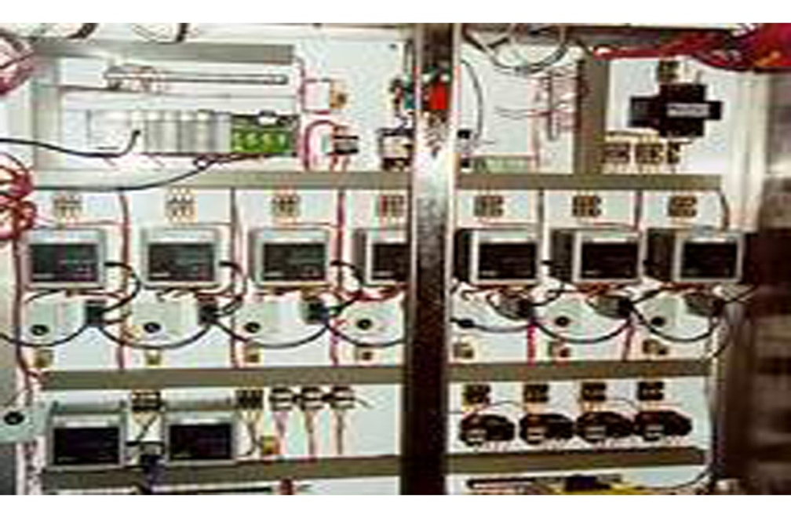
Types of wiring
Types of wiring as using.
1. Domestic Wiring
2. Commercial Wiring.
3. Industrial wiring.

Slide 5
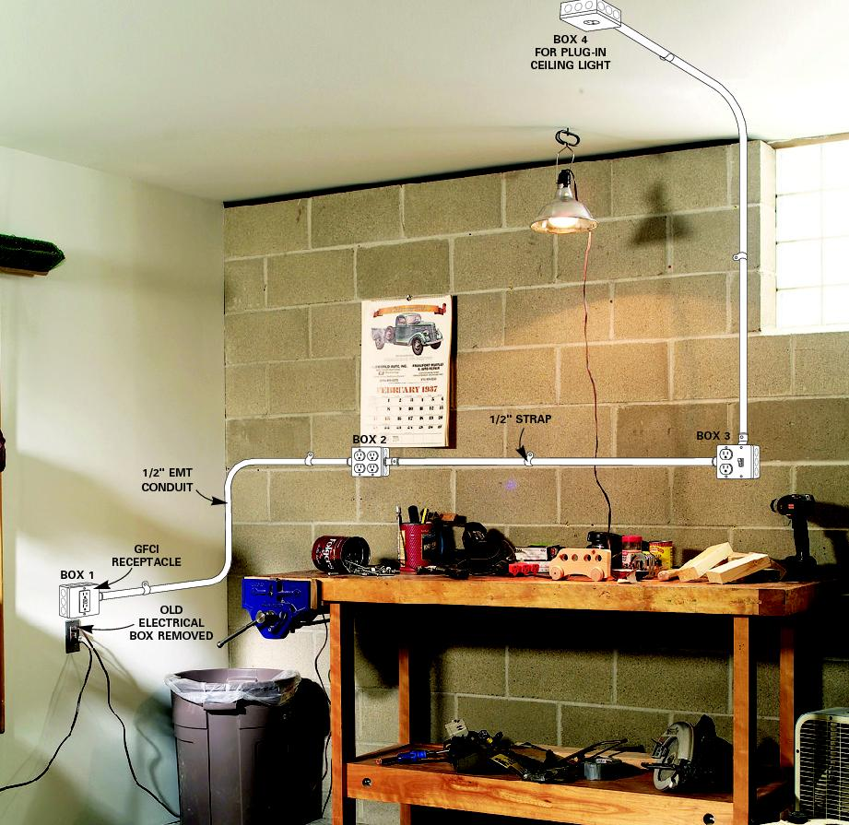
Types of wiring (Installation)
Conduit wiring
Cleat wiring( Vulcanized Insulated Rubber wire known as V.I.R. wire in porcelain cleat)
Casing Capping( V.I.R. wire in wooden casing)
T.R.S. wiring (Tough Rubber Sheath wires run over wooden battens)
Metal Sheathed Wiring(V.I.R. wires covered with lead, run over wooden battens)
Conduit wiring(V.I.R. conductors run in metallic conduits)

Slide 6
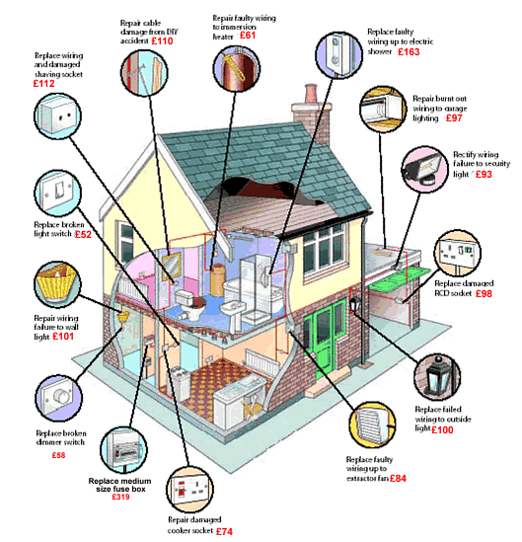

Slide 7
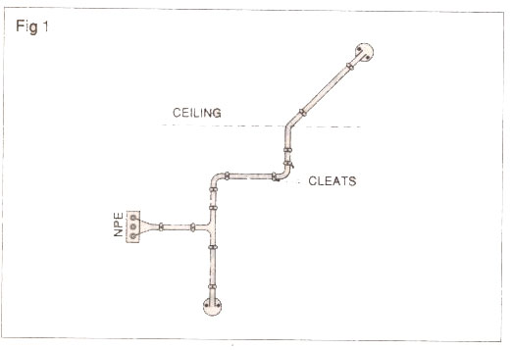
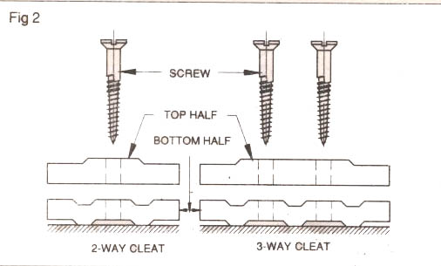
CLEAT WIRING
Not used in the very early days of house wiring.
Supported in porcelain cleats.
Two haves cleats.
cheapest
Temporary wiring

Slide 8
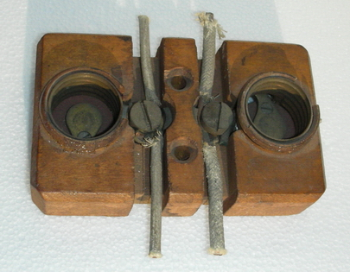
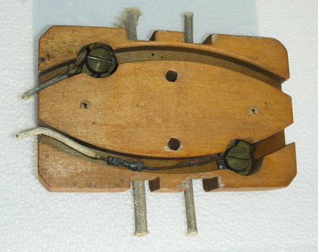
Fig. Old wooden light socket showing two top and bottom.

Slide 9
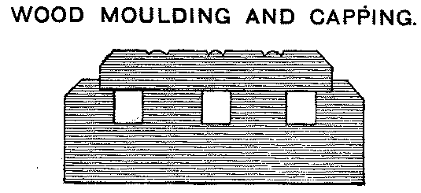
In more wealthy homes and offices, house wiring was hidden behind moldings. Grooves were cut in the base molding for the wires and simply covered with a decorative cap.
The cleats are of three types having one, two, or three grooves, so as to receive one, two or three wires.

Slide 10
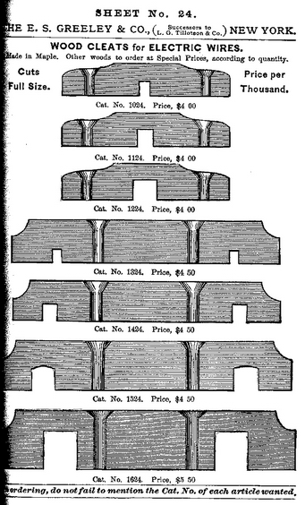
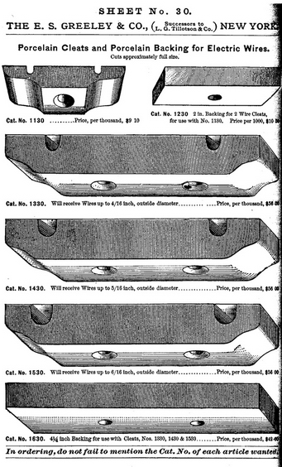
Figures showing wooden cleats and early porcelain cleats with optional porcelain backing

Slide 11
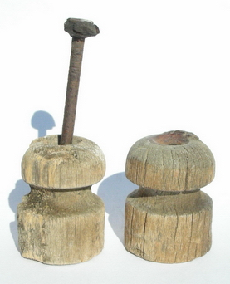
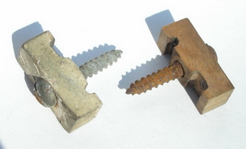
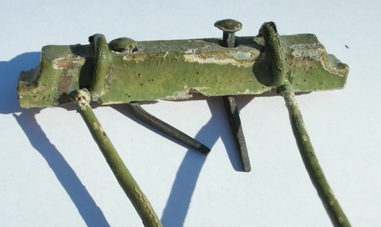
Wooden wiring knobs
This old wooden cleat still has the original paint and square nails.

Slide 12
Distance apart of wires
  For pressure up to 250 volts, cleats shall be of such dimensions that in the case of branch loads, conductors shall not be less than 2.5 cm apart, centre to centre, and in the case of sub-mains not less than 4 cm apart, centre to centre. Care shall be taken in selecting the size of cleats particularly for branch distribution wiring where two-way and three-way porcelain cleats are essential and the difference in size shall be reasonable.
Protection near the floor
  No cleat wiring shall be left unprotected up to 1.5 m above the floor level. When brought through the floor it shall be enclosed in a conduit.

Slide 13
Advantages and Disadvantages of Cleat Wiring
Advantages
Disadvantages
Cheapest method
Suitable for temporary wiring(quickly installed and recovery)
Inspection, alternation and addition can easily made
Not permitted for permanent job
Sags some places after certain period
Dust and dirt collect over them
Increased maintenance cost
Oil and Smoke are much injurious to V.I.R.
For long life, cleats should be 30 cm apart.

Slide 14
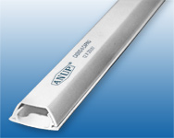
Wooden casing capping
Most commonly adopted for residential building
Rectangular woodblocks made from first class season teak wood or any other wood free from knots, shakes or shaps etc. called casing.
Casing is covered at the top by means of a rectangular strip of wood of same width called capping is screwed to it.
Double bed in capping to show the position of wire.

Slide 15
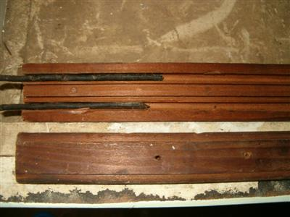
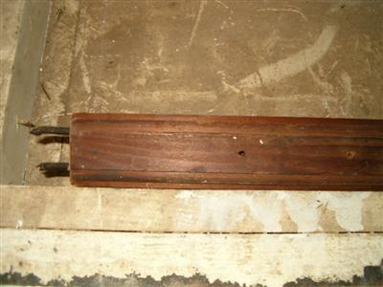
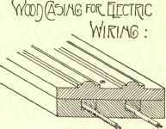
Two main disadvantages-
Highly skilled carpenters are required
Very risk of fire

Slide 16
Joints in casing capping
Types of Joint
  Straight joint.
  Tee joint.
  Right- angled joint.
  Corner joint.
  Tee-bridge joint.
  Cross- bridge joint.

Slide 17
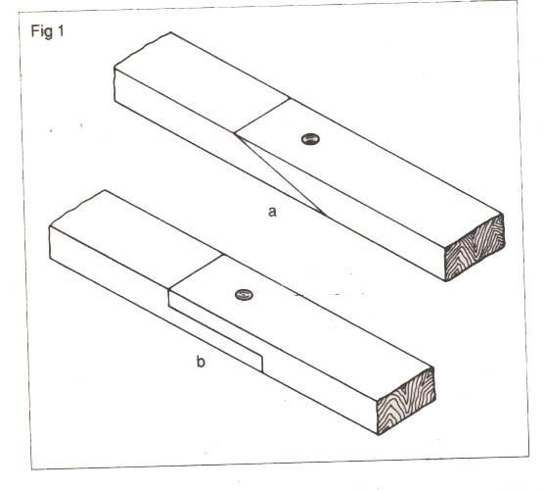
  Straight joint.

Slide 18
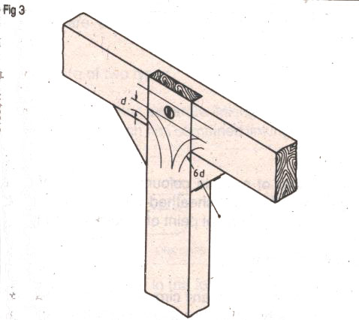
Tee joint

Slide 19
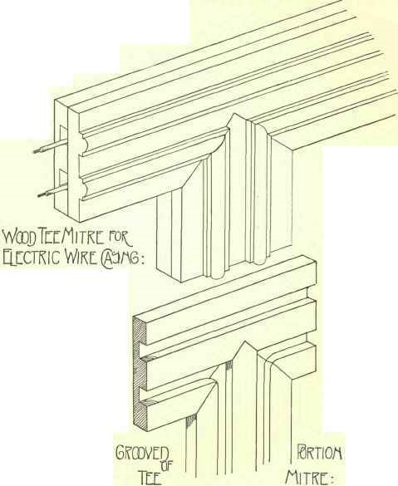
Tee joint

Slide 20
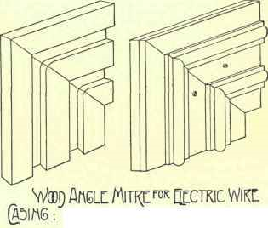
Right-angle Joint

Slide 21
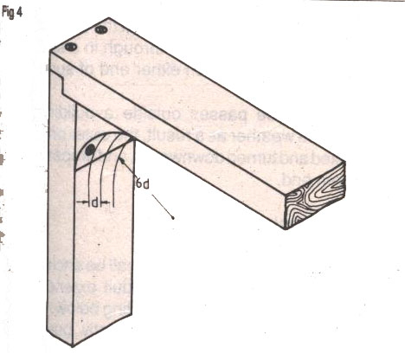
  Corner joint.

Slide 22
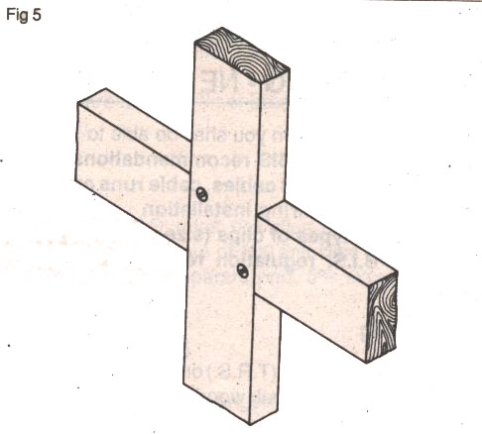
Cross- Joint

Slide 23
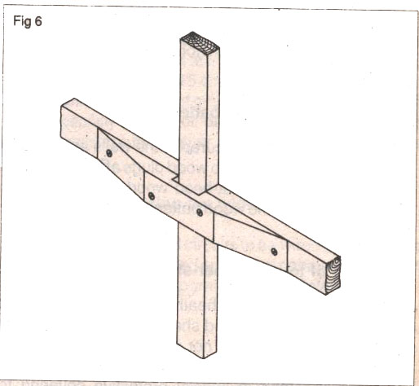
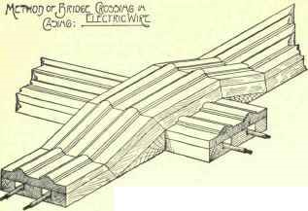
Cross- Joint

Slide 24
Tough Rubber Sheathed/Batten wiring
TRS wires are suitable for rough use, moisture, climate variations, acids alkalis but is slightly affected by lubricating oil
Tough rubber-Sheathed (T.R.S.) or PVC- Sheathed cables are suitable to run on teak wood battens which is fixed on the wall
Following considerations should be maintained-
For damp place
-take care for earth switch, lamp holders and other metal fittings.
-fibre clips should not be used
Provide a layer of neat cement over the cable(under the plaster)
Should not put under stress
Provide conduit with rubber brushing at both ends (through wall)
Wires should be properly tightened(clips should not be more than 6 cm)
Bends should have longer radius

Slide 25
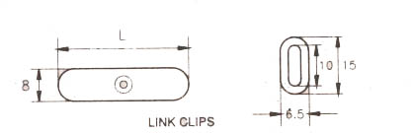
Link Clips
Link clips are used for family clipping the cables in position.
Link clips are of two types.
Link clip which has separate linking eye.
Joint link clip which has combined linking eye.
Link clip are available in the following size.
25mm, 32mm, 40mm, 50mm, 63mm, 80mm, out of which up to 40mm clips have one hole, while above that they have two holes for fixing.

Slide 26
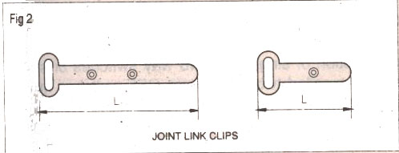
Link Clips
Link clips are made of tin or brass- coated tin or aluminum.

Slide 27
Metal Sheathed or Lead Sheathed Wiring
Rubber insulated conductor covered with an outer sheath of lead alloy containing about 95% lead which provides a protection to the cable from mechanical injury
Must be earthed, which will
-reduce the electrolytic action due to leakage current
-provides safety
Costlier than TRS

Slide 28
Following points should be kept in mind for installation of metal sheathed wiring-
Supported by proper metal clips, which must not be more than 30 cm apart(both horizontally and vertically)
No chemical action by supports with the sheath.
Avoid sharp bend and for a change of direction make round bend (with radius > 10 cm)
Lead sheathed must be earthed and have a continuous electrical contact
Not run over a damp place
When crossing wall, use conduit with bushings at both ends

Slide 29
CONDUIT WIRING
Introduction
In general, a conduit is defined as a tube or channel. Tubular conduit is the most commonly used material in electrical installations. When cables are drawn through the conduit and terminated at the outlet or switch points, the system of wiring is called conduit wiring. (Best wiring system)
Types: Surface conduit -surface of the wall and Recessed conduit
- buried under plaster

Slide 30
Conduit wiring
Metalic
Ferrous
(mild steel)
Non-ferrous
(aluminum or copper)
Non-metalic
(fibre, plastic, alkathine etc)

Slide 31
There are three types of conduits used for wiring
1. Thin wall conduit
2. Rigid conduit
3. Flexible conduit
Wiring in Conduits
1. Threading Through
2. Pushing in
3. Drawing in
Thin wall conduit
-close joint conduit: cheapest form of conduit, made out of gauge steel strips, provides only mechanical protection and cover risk against fire, not recommended for quality work.
-brazed conduits: similar to the former but the ends of the steel tubing are brazed together to make the conduit damp proof. Disadvantages-brazing material is left projecting inside the tube which make drawing in of the wire impossible

Slide 32
-Heavy Gauge Welded Conduit: made out of heavy gauge steel and tube edges are electrically welded.
-Solid Drawn Conduit: drawn from solid and no joint throughout its section, heaviest and best, costlier.
These are available in 3 m length and are threaded at two ends to provide coupling.
Rigid Conduit

Slide 33
Flexible Conduit
-made from galvanized steel, specially wound upon each other
-Concaved double strip: concave-shape steel strips spirally wound one upon the other, gasket is provided to make moisture proof.
-Flat double strip: similar to the former except that the strips are flat.
-Single strip: Single galvanized steel strip, strips have interlock, gasketed.
Double strips are preferred to single strip since-
-they are more flexible
-smother from inside
Flexible conduits are available in length up to 250 m. Costlier than rigid conduits.

Slide 34
PVC Fittings and accessories couplers
  Couplers- slip socket joint, watertight coupling, rigid conduit coupling, flexible conduit coupling, combination coupling.
  Elbow
  Bends
  Tee
  Circular boxes
  Rectangular boxes.

Slide 35
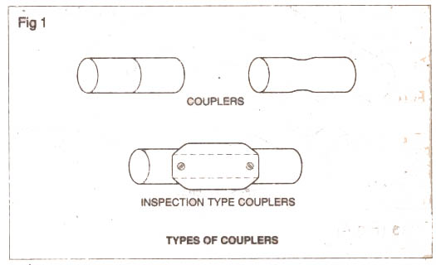
Couplers

Slide 36
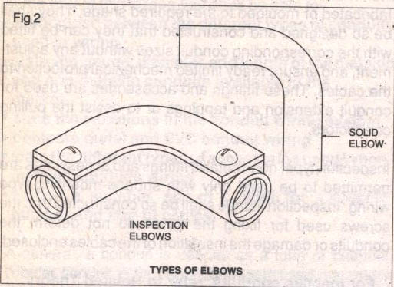
Elbow
Radius of the bend must be greater than 6 times the internal diameter of the conduit
Standard L’s are available in market
When cutting conduit, care must be taken for offset due to ell.

Slide 37
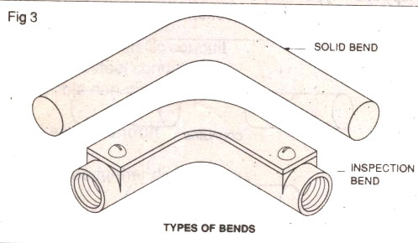
Bends

Slide 38
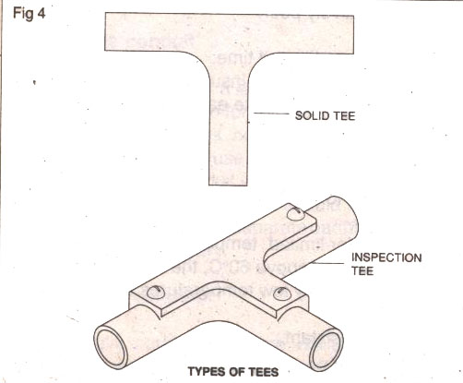
Tees

Slide 39
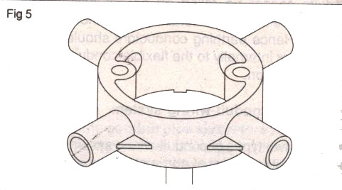
Circular boxes

Slide 40
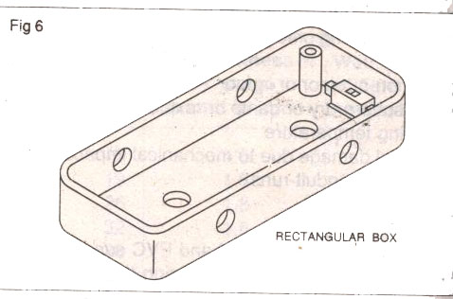
Rectangular boxes

Slide 41
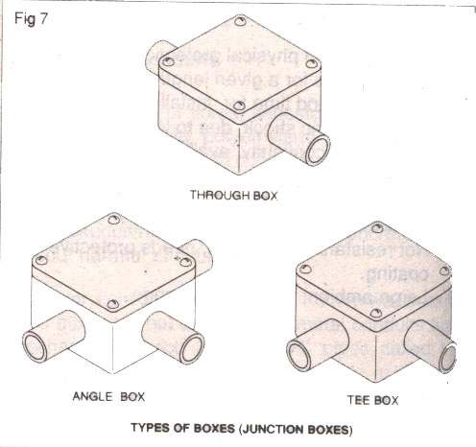
Junction Boxes

Slide 42
The answers of the following questions must be included in report
What are the various types of conduit used ?
How is the conduit cut and threaded ?
What is the use of offset and how is it obtained ?
How is the flexible conduit fixed to the conduit box ?
What do you understand by fishing wires through rigid conduit ?
What is the difference between a conduit box and a conduit fitting ?

