Slide 1
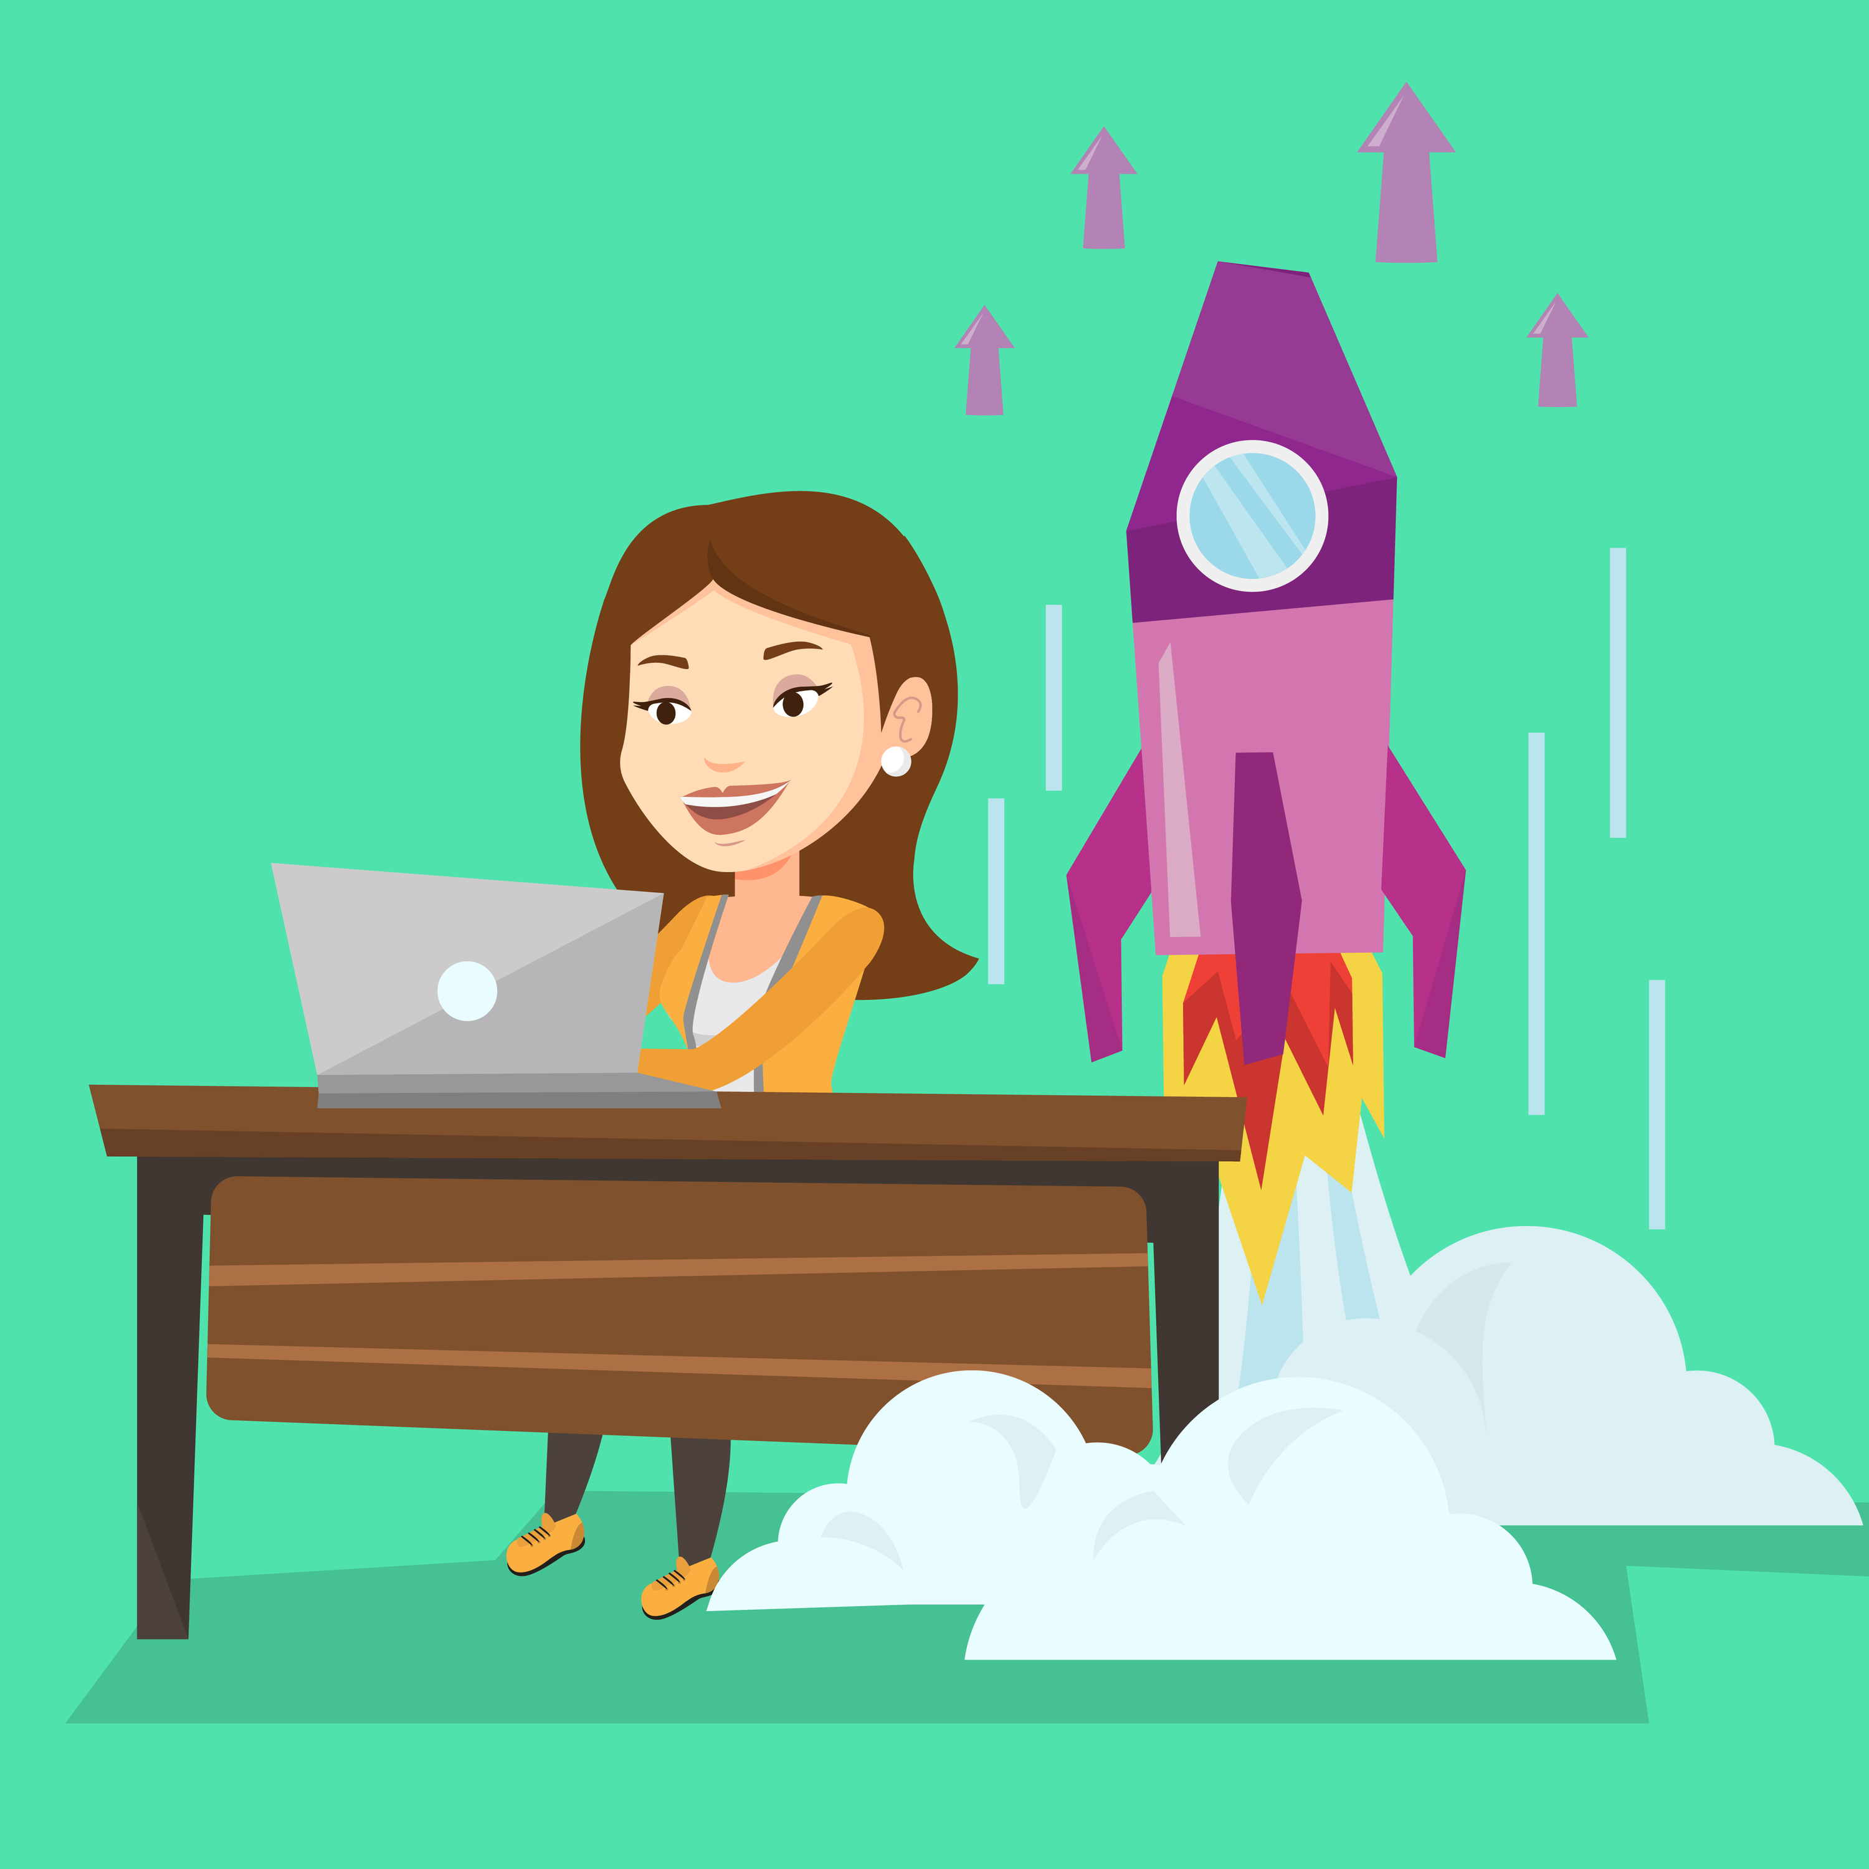
WHEN SHOULD YOU START YOUR BUSINESS?

