Slide 1

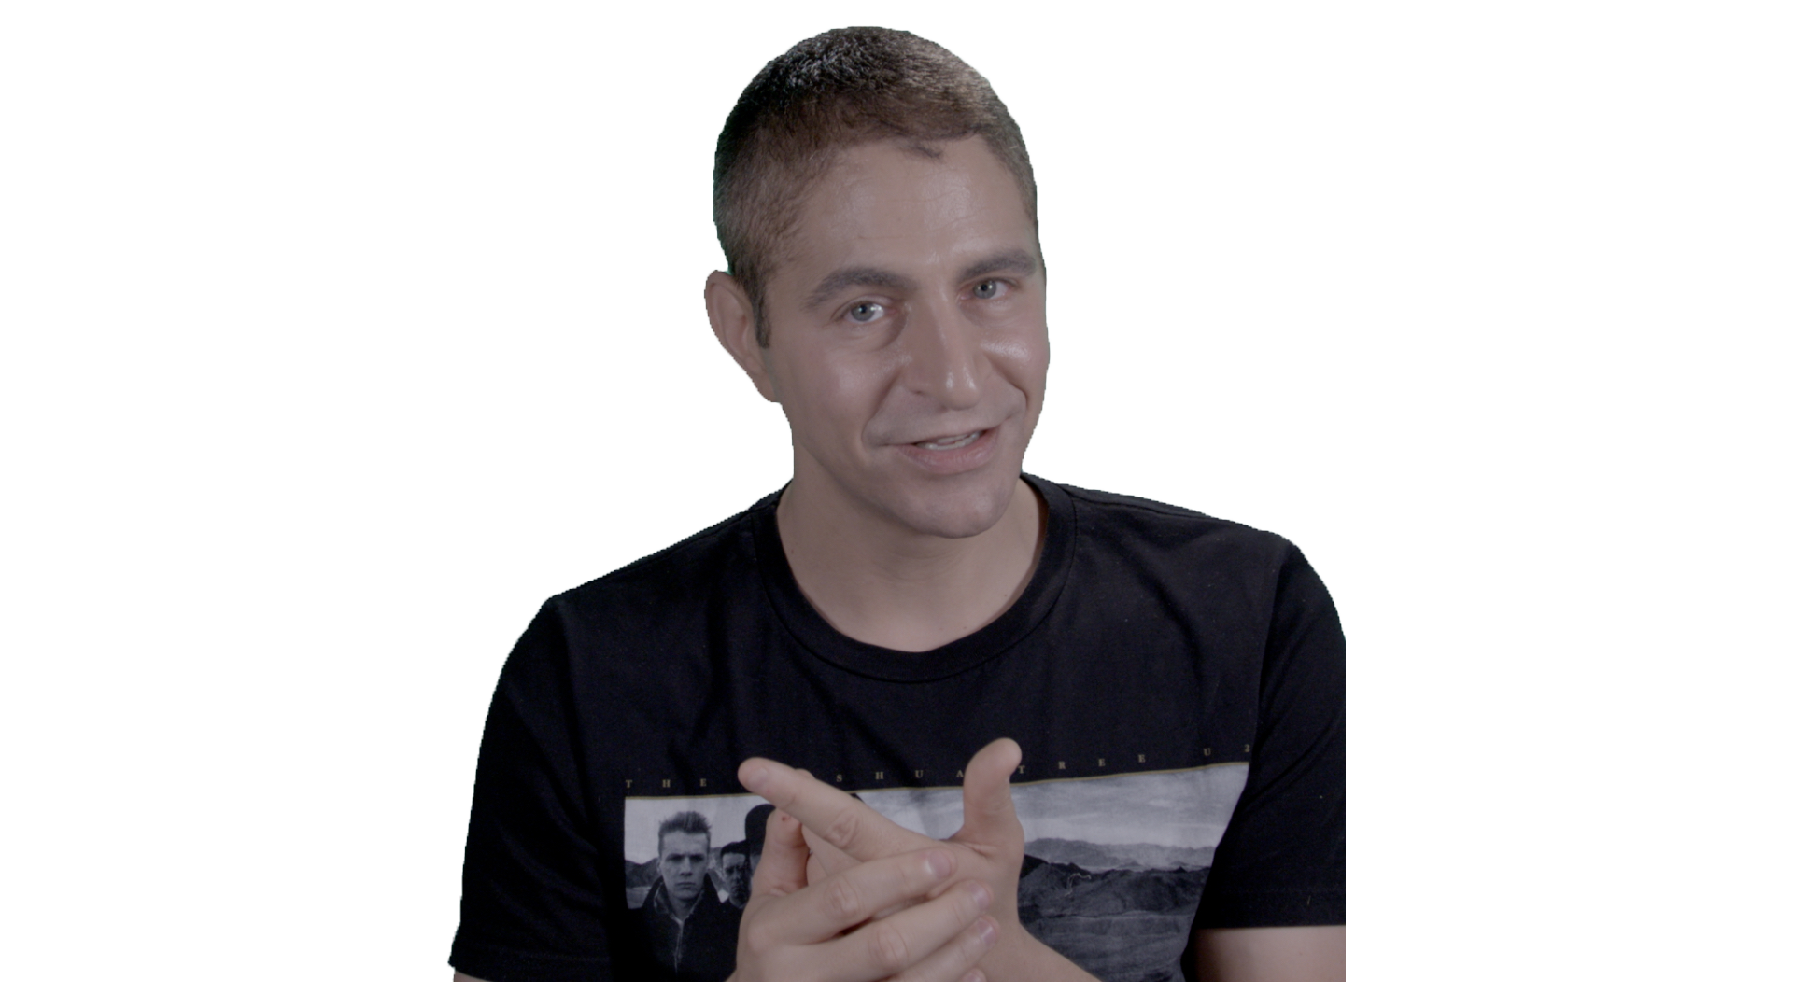

3 AMAZING
INTERVIEW
TIPS

