Slide 1

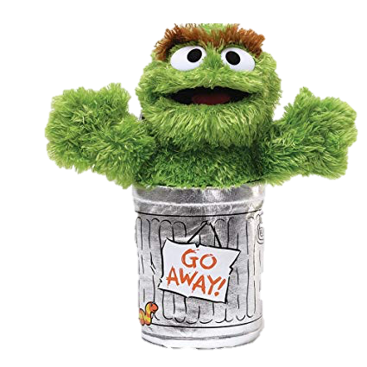
CUT THESE PEOPLE OFF
(GET THEM OUT OF YOUR LIFE)
EPISODE #56

